Slide 1


Hii, Iam siddhika
Welcome to Power BI Series
Part -10

Slide 2

Today Content
Are you ready guys?
continuing with
CREATING A DATA MODEL
FACT & DIMENSION TABLES RELATIONSHIPS VS. MERGED TABLES THE MODEL VIEW

Slide 3

FACT & DIMENSION TABLES
Data models generally contain two types of tables:
fact (“data”) tables, and dimension (“lookup”) tables
Have you got it?
Fact Table: Think of it as a table where you store numbers or facts about a business, like sales amounts or quantities sold. Each row represents a specific business activity, like a sale or transaction
Dimension Table: Imagine it as a table that gives more details about the facts in the fact table. It contains descriptive information, like product names, customer details, or dates. Dimension tables help you understand the context of the facts in the fact table.

Slide 4
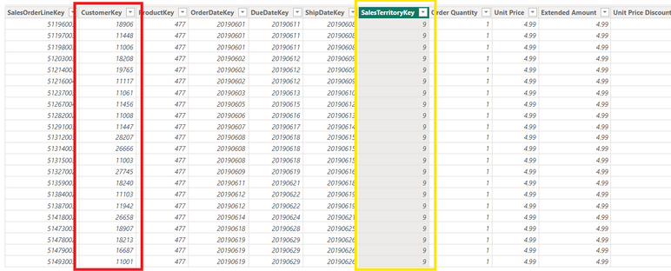
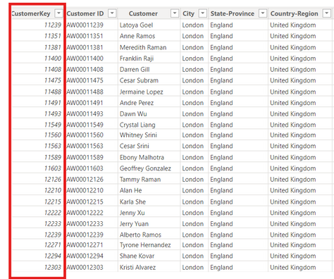
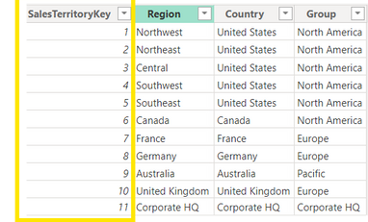
Fact Table
Let’s see
with example
Common column SalesTerritoryKey in both tables. in dim table which tells detailed of of that column
Dimension Table
Common column Customer key in both tables

Slide 5
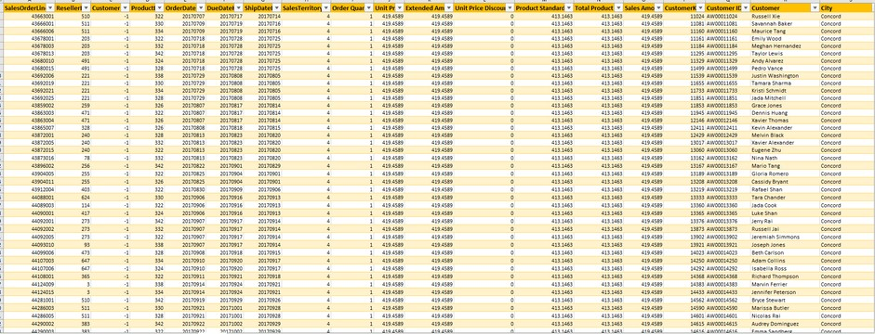

Can’t I just merge
queries or use lookup
Attributes from customer Lookup tabl
functions to pull everything into one single table?
Original Fact Table field
You can, but it’s extremely inefficient!
Merging tables creates redundancy and often requires significantly more memory and processing power to analyze
compared to a relational model with multiple small tables

Slide 6
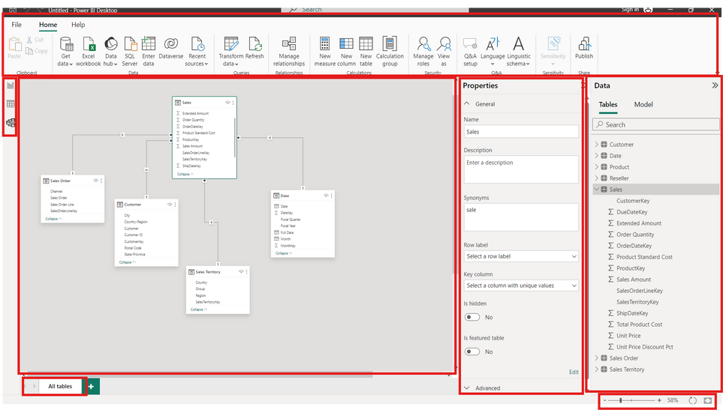

Look at once
Menu Ribbon (Home, Help)
Data / Field List
Properties pane
(Name, synonym, format, etc.)
View Options (Zoom, Reset Layout, Fit to Page)
Model layout tabs
Model canvas

Slide 7


Thank you for joining me today to learn about Part -10 of Power BI!
Remember, a well-organized data model is key to unlocking valuable insights from your data.
Stay tuned for more insights and tips on Power BI in our next Series.
Follow
Varsha Chitikaneni

